Slide 1
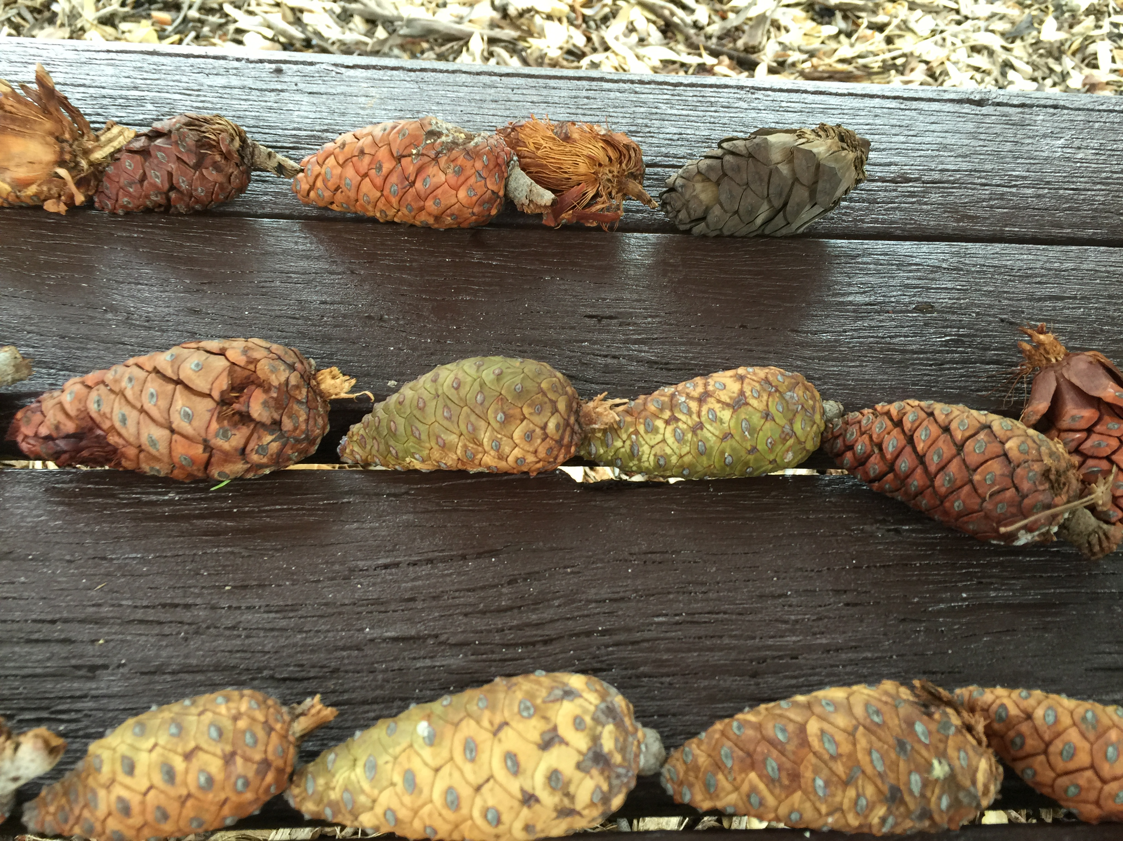
Understanding Community participation in cure studies: what scientists need to know

Slide 2
I want to begin my presentation by
thanking people living with HIV
past, present and future
who have generously shared their time, talent, experiences, and bodies for the purposes of research.
I acknowledge, appreciate, honor and respect
your acts of love
to & for us

Slide 3
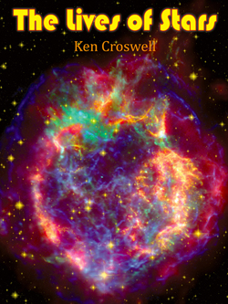
Our HIV journey is a love story
Pic source – Ken Crosswell, The lives of Stars

Slide 4
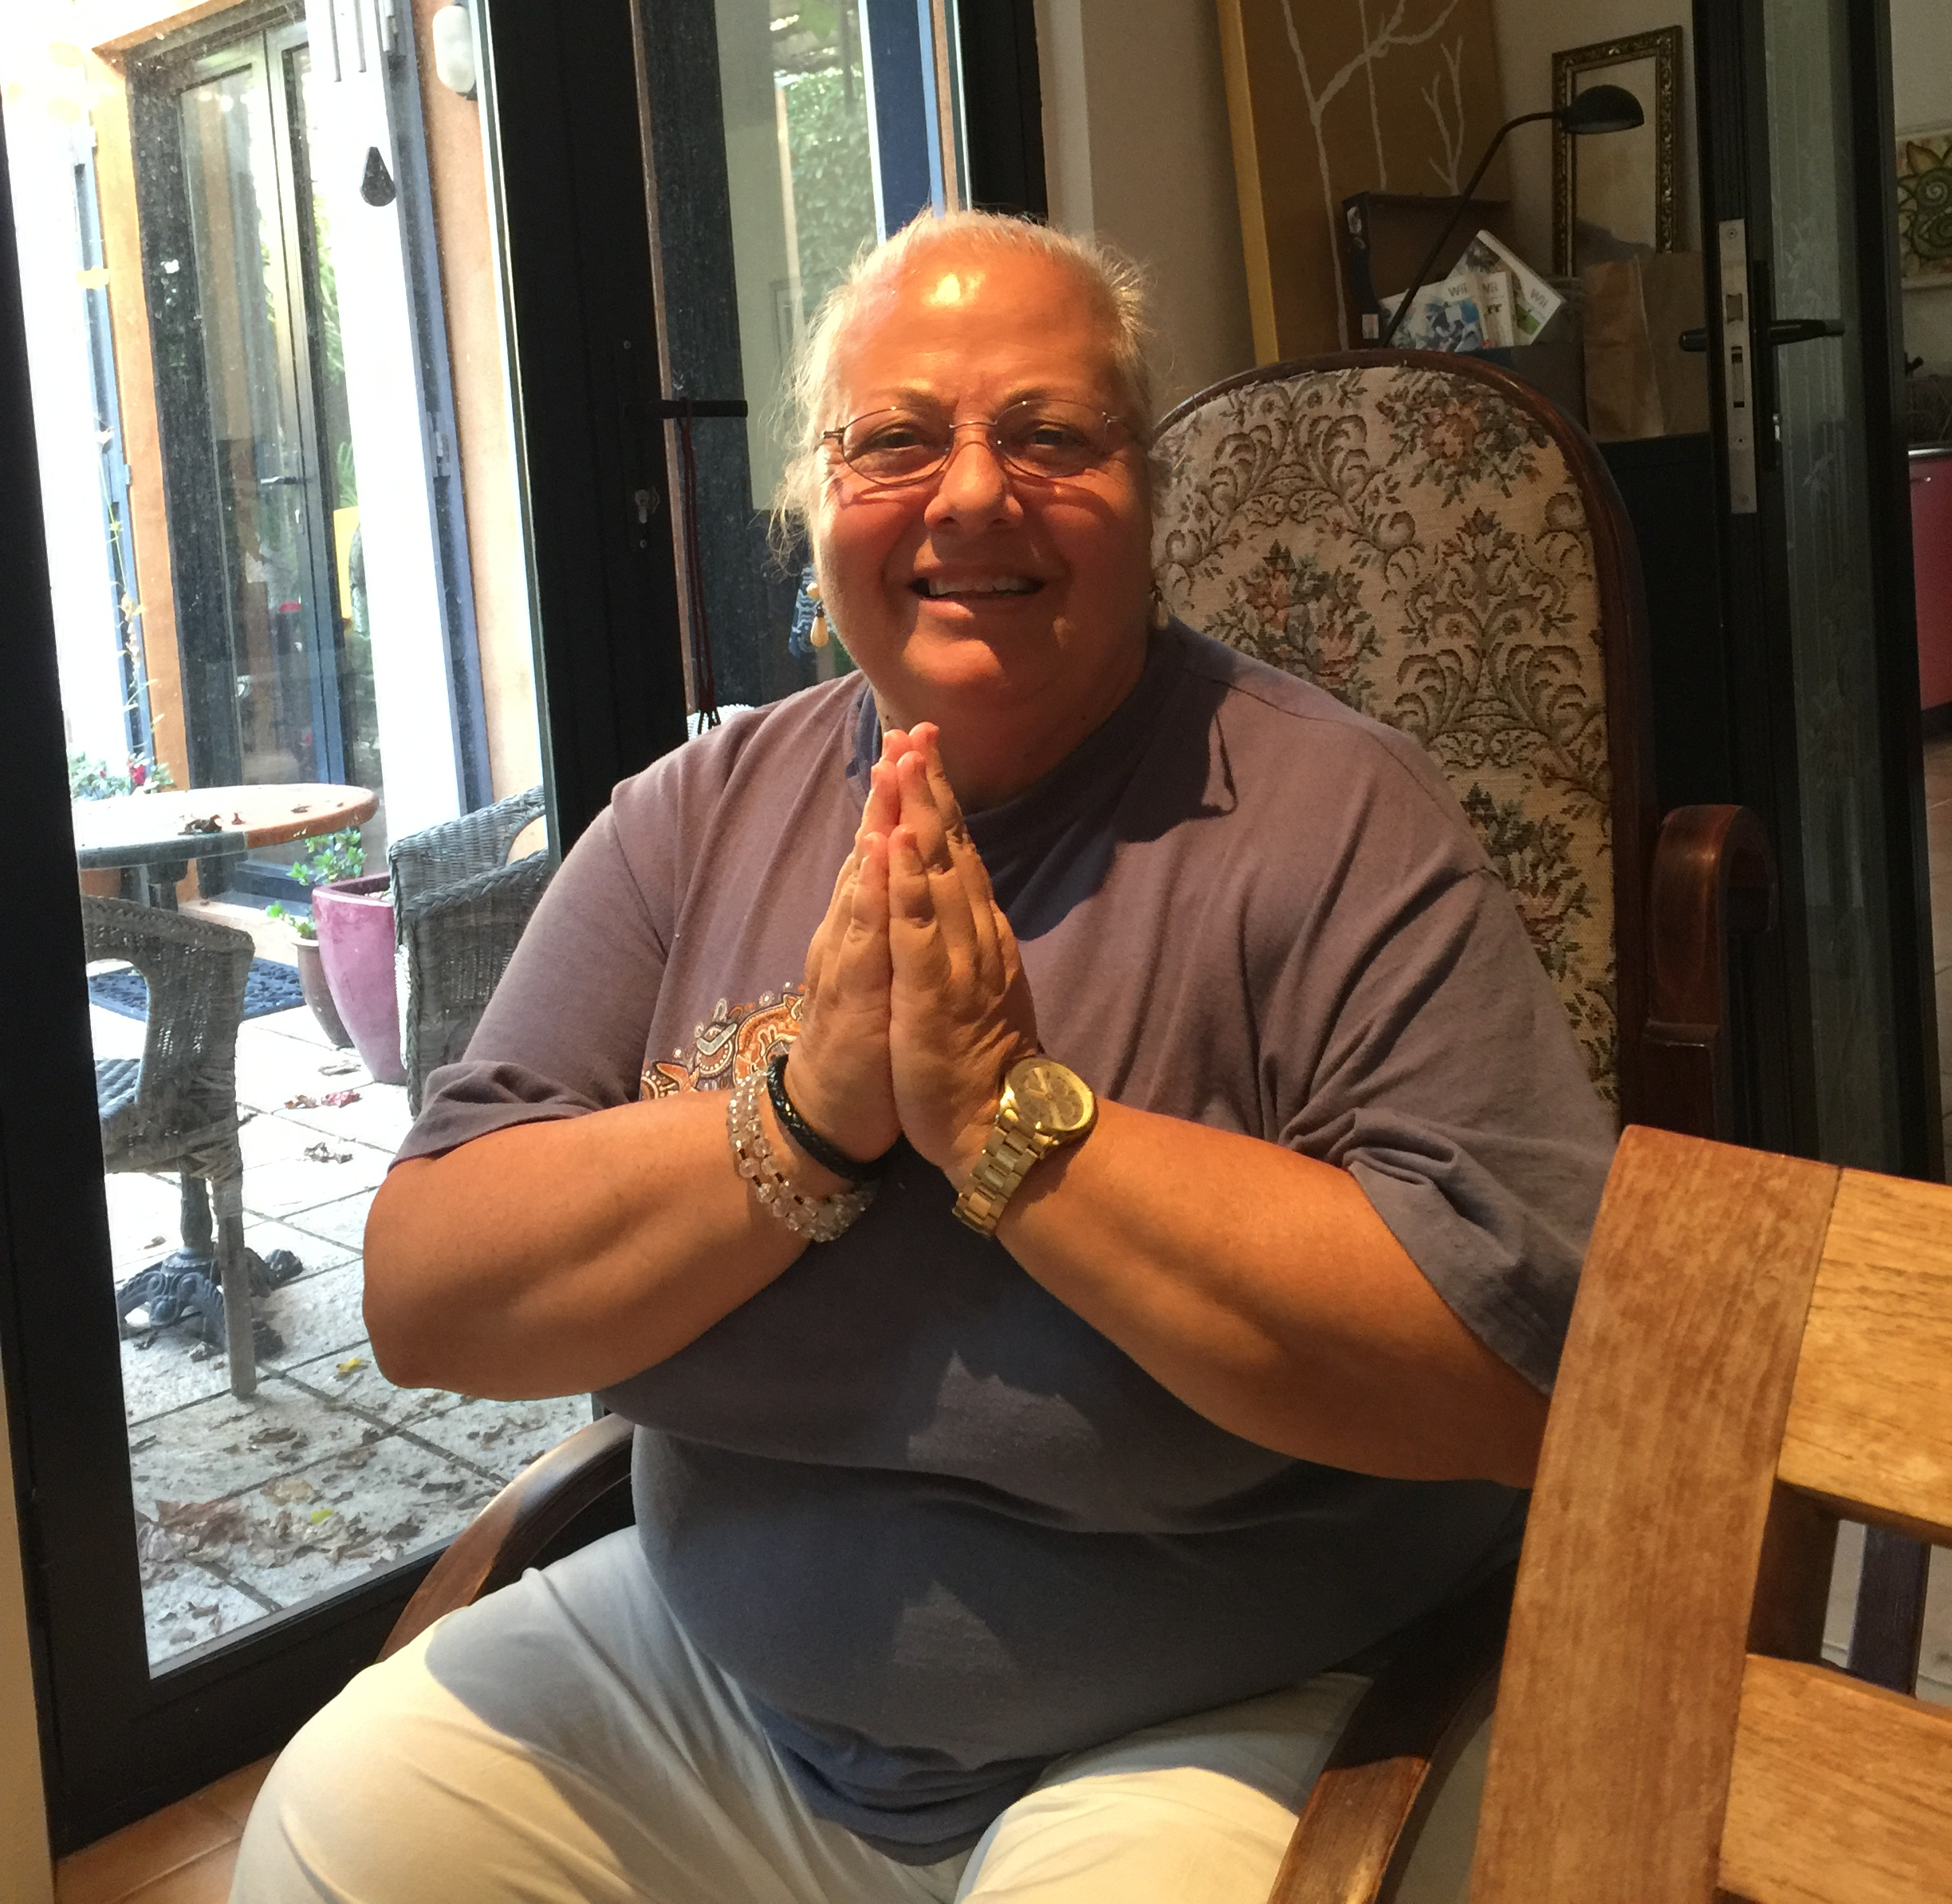
The Love Cascade or The Love Care Continuum

Slide 5
Choosing to love builds bridges breaks down barriers collaborates and gives joyfully co-creates

Slide 6
We are scientists with you!
Since the beginning we have engaged in finding a cure
Many of us live with and can handle uncertainty e.g. starting ARV, oral sex
We trusted you with our lives thankyou we trust you, we trust, we trust,
well actually we love you ☺

Slide 7
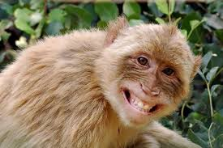
Loving to know & trials
Risks & Benefits | Global North Context? | Global South Context? | Each Participant Context?
What I know is ….. | Consent Monitor Respond | Consent Monitor Respond | ‘’
What I know I don’t know is….. | ‘’ | ‘’ | ‘’
Unknowns…. | Optimise collaboration | Optimise collaboration | Optimise collaboration
Do good – when we know better we do better
Do no harm – contain minimise
Autonomy – informed consent
Equity, Fairness – Inclusion

Slide 8
Loving consideration – next steps
Protect our partners e.g. context matters, PrEP, a Rapid Home HIV Viral Test (trials TI, remission, u=u, nature of relationships, vaccine, min resistance)
TI, are you ready to switch?
Global, ready to go, opt in, participant ready in research/trial data set, individual values, beliefs, context and willingness and politics.
Honour role of participants with bios & personal story
Be at the table with you to design research/trials and protocols, GIPA & MIPA
Be your champion when you fail, HIV humbles everyone.
Be with you to share our success

Slide 9
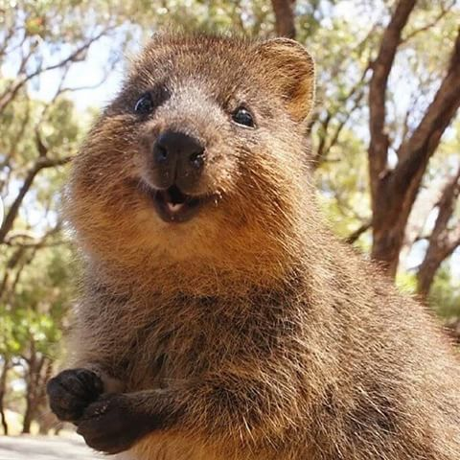
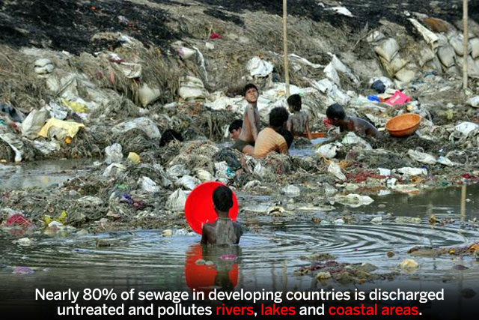
HIV, Ebola, ……?....? How does love choose to respond in that moment?
consumption of health commodities for profit $ is
health care less
With loving health care

Slide 10
Next year we have the chance to lovingly save a million lives, a million points of loving light. Yes its worth it! Yes love is worth it! Yes I will participate in a cure trial yes I choose to give love

Slide 11
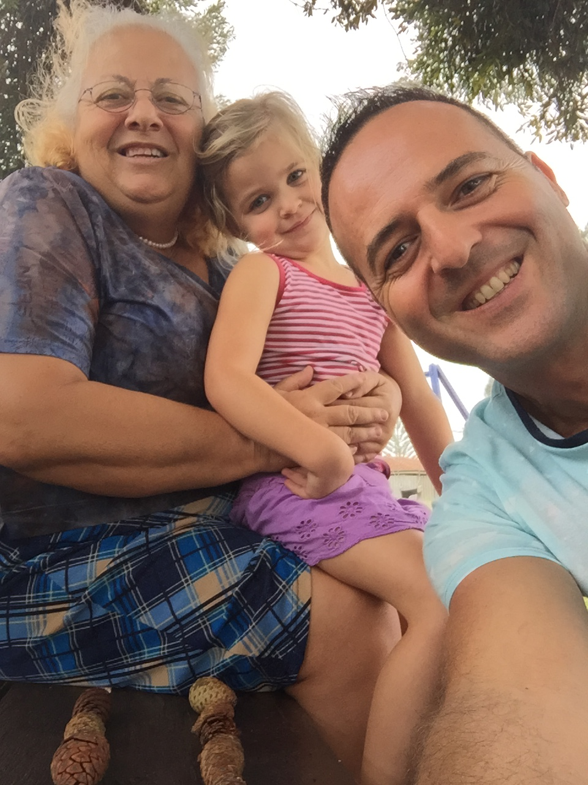
Thank everyone for being a part of loving health care

